Slide 1

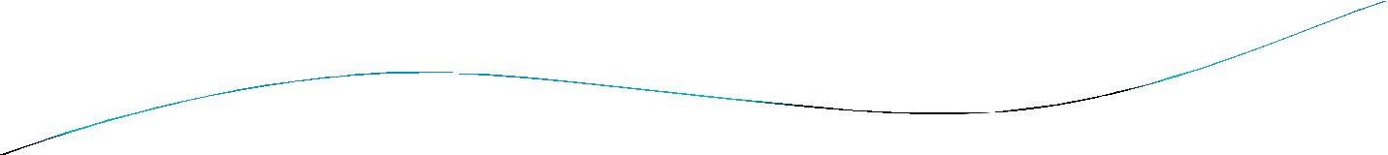


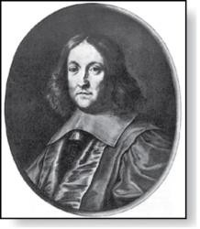
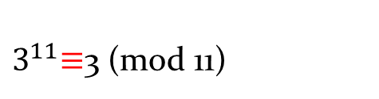
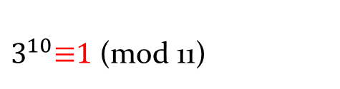
Fermat’s Little Theorem
Pierre de Fermat (1601-1665)
Theorem 3: (Fermat’s Little Theorem) If p is prime and a is an integer not divisible by p, then a^{p-1} ≡ 1 (mod p)
Furthermore, for every integer a we have a^{p} ≡ a (mod p)
(proof outlined in Exercise 19)
Fermat’s little theorem is useful in computing the remainders modulo p of large powers of integers.
Example: Find 7²²² mod 11.
By Fermat’s little theorem, we know that 7¹⁰ ≡ 1 (mod 11), and so (7¹⁰ )^{k} ≡ 1 (mod 11), for every positive integer k. Therefore,
7²²² = 7^{22∙10 + 2} = (7¹⁰)²²7² ≡ (1)²² ∙49 ≡ 5 (mod 11).
Hence, 7²²² mod 11 = 5.
$3^{11}\text{≡}$3 (mod 11)
$3^{10}\text{≡}\text{1}$ (mod 11)

Slide 2

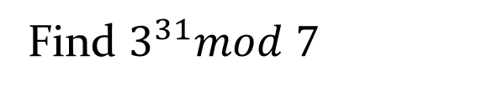


Examples
Find $3^{31}mod 7$
$$\text{(}\text{3}\text{6}\text{)}\text{5}\text{3}\text{1}=3 mod 7$$
Find $2^{35}mod 7$
$$\text{(}\text{2}\text{6}\text{)}\text{5}\text{2}\text{5}=4 mod 7$$

Slide 3


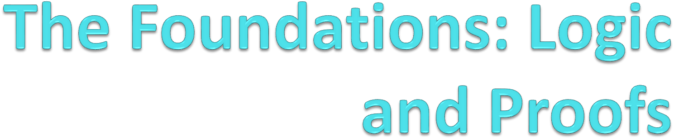

Slide 4

Proofs
A proof is a valid argument that establishes the truth of a mathematical statement.
Ingredients:
hypotheses of the theorem
axioms assumed to be true
previously proven theorems
rules of inference
You get: truth of the statement being proved

Slide 5
Usefulness
Computer Science
Verifying that computer programs are correct.
Establishing that operating systems are secure.
Making inferences in artificial intelligence.
Showing that system specifications are consistent.
Mathematics
Defining Formalism.
Providing specification in a common language.
Justification for the results.

Slide 6
Definitions
1. An integer n is even if, and only if, n = 2k for some integer k.
2. An integer n is odd if, and only if, n = 2k + 1 for some integer k.
3. An integer n is prime if, and only if, n > 1 and for all positive integers
r and s, if n = r·s, then r = 1 or s = 1.
4. An integer n > 1 is composite if, and only if, n = r·s for some positive integers r and s with r ≠ 1 and s ≠ 1.
5. A real number r is rational if, and only if, r= 𝑏 for some integers a and b with b ≠ 0.
6. If n and d are integers and d ≠ 0, then d divides n, written d|n if, and
only if, n = d.k for some integers k.
7. An integer n is called a perfect square if, and only if, n = 𝑘^2 for some integer k.

Slide 7
Definitions
An integer n is even if, and only if, n = 2k for some integer k.
An integer n is odd if, and only if, n = 2k + 1 for some integer k.
An integer n is prime if, and only if, n > 1 and for all positive integers
r and s, if n = r·s, then r = 1 or s = 1.
An integer n > 1 is composite if, and only if, n = r·s for some positive integers r and s with r ≠ 1 and s ≠ 1.
A real number r is rational if, and only if, r= _{𝑏} for some integers a and
b with b ≠ 0.
If n and d are integers and d ≠ 0, then d divides n, written d|n if, and
only if, n = d.k for some integers k.
An integer n is called a perfect square if, and only if, n = 𝑘² for some integer k.
𝑎

Slide 8

Types of Proofs
Proving conditional Statements
Direct Proofs
Indirect Proofs
Proof by Contraposition
Proofs by Contradiction
Proving Non-conditional Statements
Indirect Proofs
If-And-Only-If Proof
Constructive Versus Non-constructive Proofs
Existence Proofs; Existence and Uniqueness Proofs
Disproofs (Counterexample, Contradiction, Existence Statement)
Proofs Involving Sets
Mathematical Induction

Slide 9
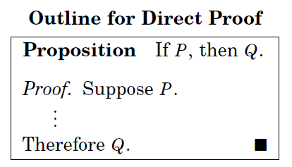
Direct Proofs
p →q
first step is the assumption that p is true
subsequent steps constructed using rules of inference.
final step showing that q must also be true
showing that if p is true, then q must also be true, so that the combination
p true and q false never occurs

Slide 10


Activity Time
Prove that the sum of two odd integers is even.

Slide 11
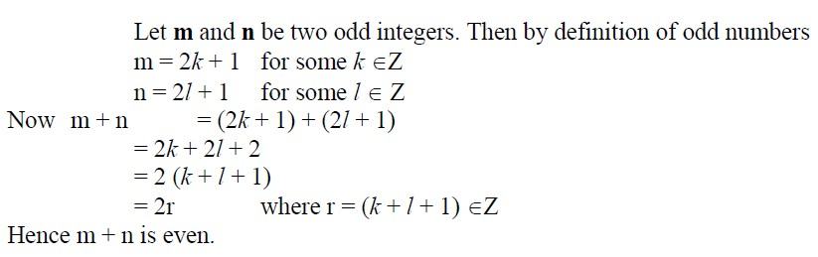
Prove that the sum of two odd integers is even.

Slide 12

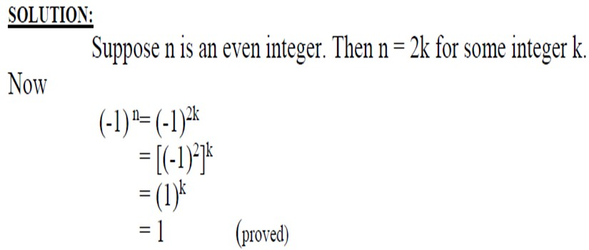

Slide 13

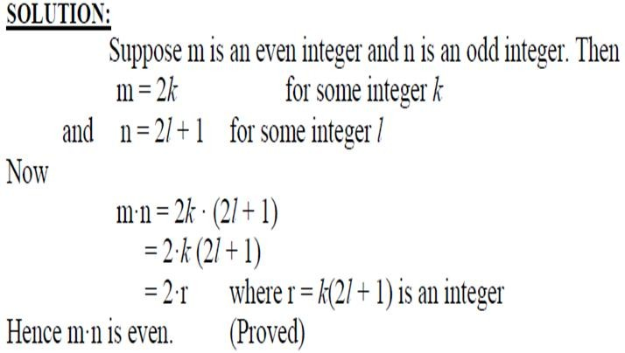

Slide 14

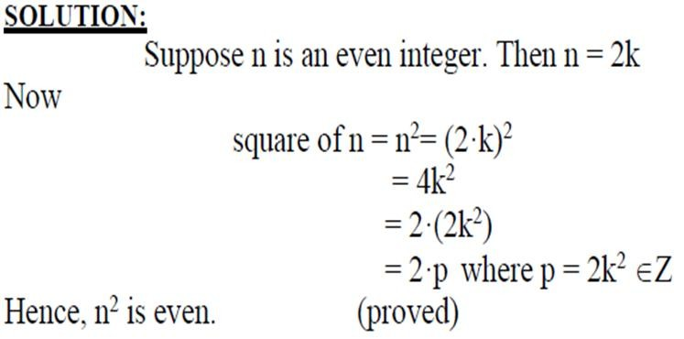

Slide 15
proved that if n is an odd integer, then n² is an odd integer
We assume that the hypothesis of this conditional statement is true, namely, we assume that n is odd.
By the definition of an odd integer, it follows that n = 2k + 1, where k is some integer.
Square both sides n² = (2k + 1)²
4k² + 4k + 1 = 2(2k² + 2k) + 1.
Consequently, we have proved that if n is an odd integer, then n² is an odd integer

Slide 16

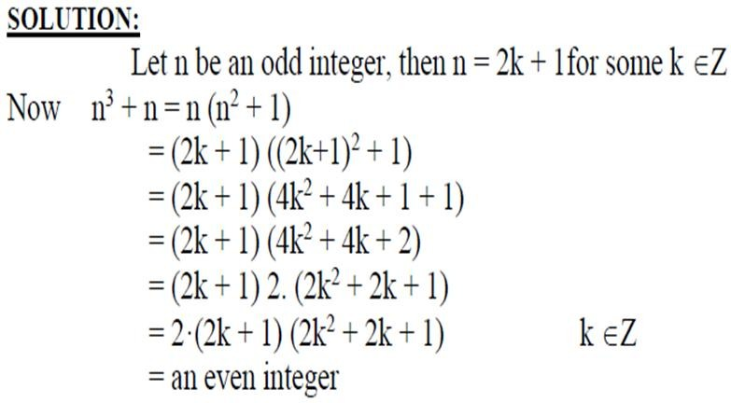

Slide 17
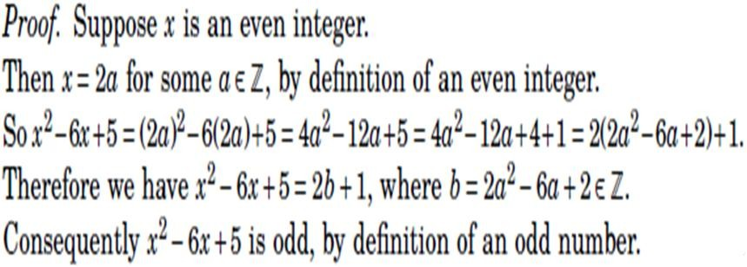

Slide 18

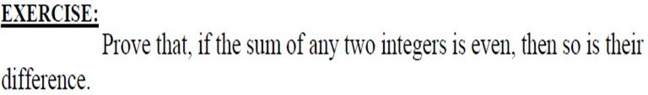
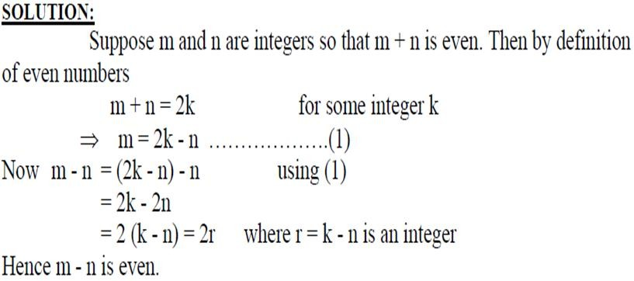

Slide 19
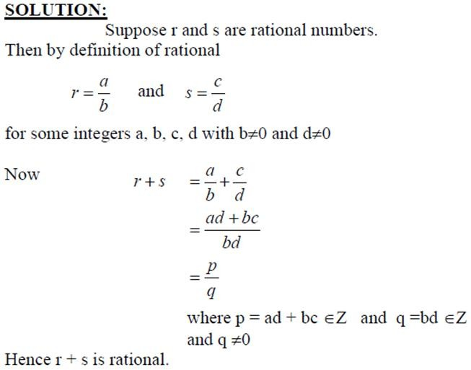

Slide 20

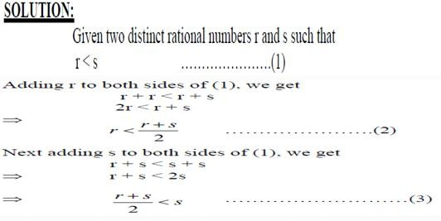

Slide 21
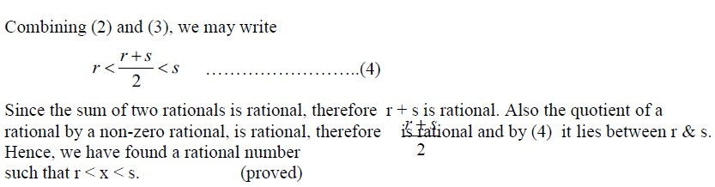

Slide 22

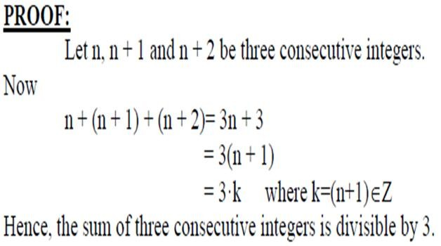

Slide 23
Activity Time
Give a direct proof that if m and n are both perfect squares, then nm is also a perfect square.

Slide 24
Proof
We assume that the hypothesis of this conditional statement is true, namely, we assume that m and n are both perfect squares.
By the definition of a perfect square, It follows that there are integers s and t such that m = s² and n = t².
Multiplying both m and n to get s²t².
Hence, mn = s²t² = (ss)(tt) = (st)(st) = (st)², using commutativity and associativity of multiplication.
By the definition of perfect square, it follows that mn is also a perfect square, because it is the square of st, which is an integer.
We have proved that if m and n are both perfect squares, then mn is also a perfect square.

Slide 25
Indirect Proofs
Direct proof begin with the premises, continue with a sequence of deductions, and end with the conclusion.
Attempts at direct proofs often reach dead ends
Proofs that do not start with the premises and end with the conclusion, are called indirect proofs

Slide 26

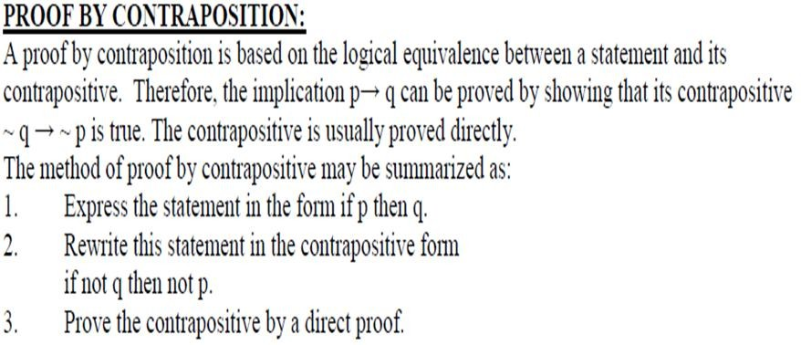
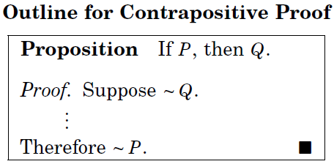

Slide 27
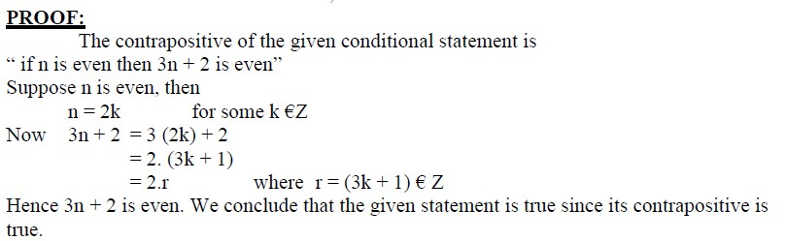
Prove that if n is an integer and 3n + 2 is odd, then n is odd.

Slide 28

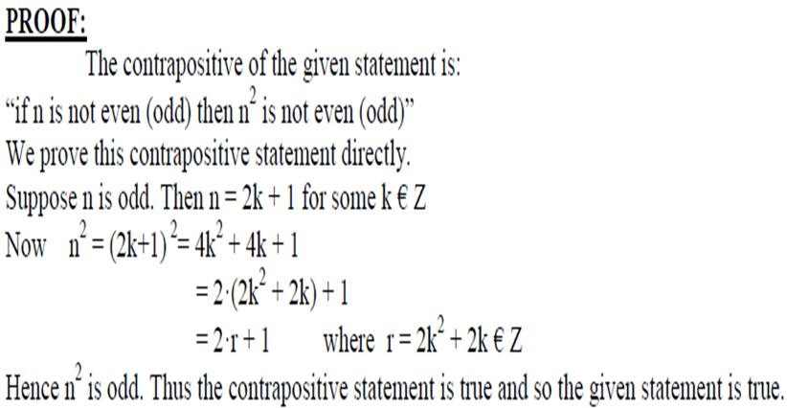

Slide 29

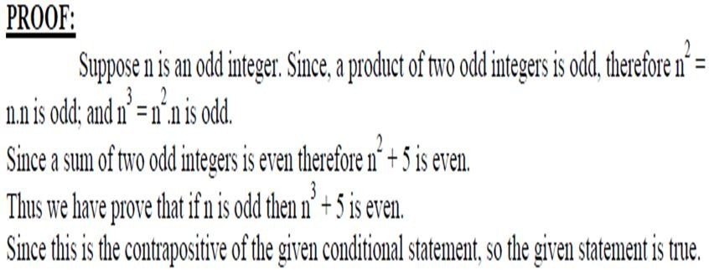

Slide 30


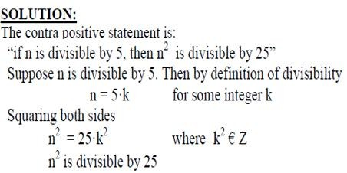

Slide 31
Proofs by Contradiction
A proof by contradiction is based on the fact that either a
statement is
true or it is false that the statement to
but not both. Hence the be proved is false, leads
supposition,
logically to a contradiction, impossibility or absurdity, then the supposition must be false. Accordingly, the given statement must be true.
The method of proof by contradiction may be summarized as follows:
Suppose the statement to be proved is false.
Show that this supposition leads logically to a contradiction.
Conclude that the statement to be proved is true.

Slide 32
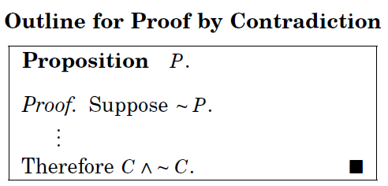
Basic Idea
Assume that the statement we want to prove is false, and then show that this assumption leads to nonsense!
We are then led to conclude that we were wrong to assume the statement was false,
so the statement must be true.

Slide 33


